Slide 1

Cyclone Sensor Machine Analysis
Comprehensive data science project demonstrating end-to-end machine learning workflows
Task 1: Machine Data Analysis & Time Series Forecasting
Task 2: RAG + LLM System Design for Industrial Documentation
- By Anish Joshi

Slide 2

Task 1: Problem Definition & Dataset Overview
Dataset Characteristics
Business Objectives
Detect and predict machine shutdowns
3 years of continuous sensor data
Segment operational states automatically
~370,000 records at 5-minute intervals
Identify anomalous behavior patterns
Multiple temperature and pressure sensors
Forecast inlet gas temperature trends
Material outlet temperature monitoring

Slide 3
Data Preparation & Preprocessing
01
02
Data Quality Assessment
Time Series Standardization
Identified missing values, timestamp gaps, and statistical outliers across all sensor channels
Enforced strict 5-minute indexing and handled irregular sampling intervals
03
04
Exploratory Analysis
Behavior Visualization
Generated summary statistics, correlation matrices, and temporal behavior patterns
Analyzed weekly and yearly patterns to distinguish normal vs. variant operational states

Slide 4
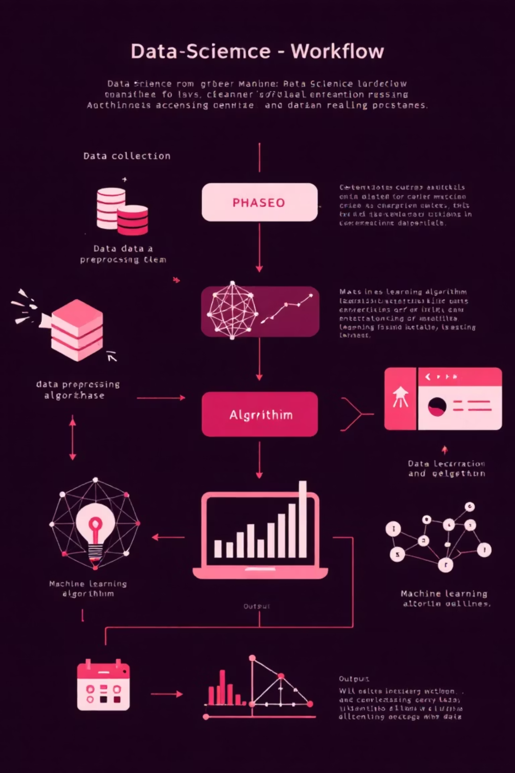
Analysis Methods & Algorithms
Shutdown Detection
Developed automated flagging system for idle periods and calculated total operational downtime metrics
State Clustering (K-Means)
Identified interpretable machine states: Normal, High Load, Degraded, and Transitional operations
Anomaly Detection
Implemented contextual, state-aware detection using Isolation Forest and rolling MAD thresholds
Time Series Forecasting
Deployed ARIMA and Prophet models, benchmarked against persistence baseline performance

Slide 5

Key Insights & Findings
Predictive Shutdown Patterns
State-Based Anomaly Distribution
Forecasting Performance Insights
Shutdown events concentrated during specific operational states, enabling early warning systems for maintenance scheduling
Degraded operational states showed significantly higher anomaly density, indicating equipment stress patterns
Effective predictions achieved only under stable operational regimes due to inherent non-stationarity challenges
Actionable Recommendation: Monitor transitions into "risky states" to trigger proactive maintenance alerts and prevent unexpected downtime

Slide 6

Task 2: RAG System Problem & Requirements
Business Challenge
Operations team manages 50+ PDF documents including manuals, SOPs, and troubleshooting guides
Need for intelligent natural-language Q&A system: "What does a sudden draft drop indicate?"
Technical Requirements
Open-source technology stack only
Reliable responses with source citations
Scalable architecture for future growth
Robust against AI hallucination risks

Slide 7





RAG System Architecture
Document Ingestion & Preprocessing
Automated PDF parsing and text extraction with metadata preservation
Smart Chunking Strategy
Optimized 200-400 token segments with strategic overlap for context preservation
Embeddings & Vector Storage
all-MiniLM-L6-v2 embeddings stored in FAISS index for efficient similarity search
Hybrid Retrieval System
Dense semantic search combined with lexical reranking for optimal relevance
LLM Generation with Citations
flan-t5-small model with enforced source attribution and response validation

Slide 8



System Guardrails & Evaluation Framework
Quality Guardrails
Performance Evaluation
Scalability Planning
Graceful fallback for low-relevance queries
Precision@k and recall@k metrics
Sharded FAISS or Chroma for 10x documents
Mandatory source citations in all responses
Faithfulness scoring for accuracy
Microservices + autoscaling for 100+ users
Sensitive query filtering and blocking
Results stored in evaluation.csv
CPU embeddings and caching for cost optimization

Slide 9

Project Outcomes & Business Impact
Task 1: Machine Analytics Framework
1
Delivered comprehensive end-to-end analysis pipeline covering shutdown detection, state clustering, anomaly identification, and forecasting capabilities
2
Task 2: RAG System Prototype
Designed and implemented production-ready RAG system with robust guardrails, comprehensive evaluation metrics, and detailed scalability roadmap

Slide 10


Next Steps & Future Enhancements
Task 1 Improvements
Key Demonstration
Integrate domain expert labels for supervised anomaly classification
Both projects showcase complete end-to-end data science workflows from raw sensor data analysis to applied NLP system development
Implement real-time monitoring dashboard
Develop predictive maintenance scheduling
Task 2 Enhancements
Upgrade to Llama-2 7B model for higher fidelity responses
Enhanced reranking algorithms
Multi-language document support

